Slide 1
English for Seminar & Presentation
By Phatcharakran Intanaga
English Division, Faculty of Humanities
Chiang Mai University
February 7, 2018

Slide 2
ENGLISH FOR PRESENTATIONS AND SEMINAR
Good Presentation
Presenter ➔ confident
Audience ➔ confident
success

Slide 3
1. PREPARATION AND PLANNING
Essential preparation & planning checklist
Questions to ask yourself | My ideas
Objective
Why am I making this presentation?
Your objective should be clear in your mind.
Audience
Who am I making this presentation to?
How many people?
Venue
Where am I making this presentation?
A small meeting-room or a large conference hall?
Facilities and equipment?
Seating arrangements?

Slide 4
1. PREPARATION AND PLANNING
Questions to ask yourself | My ideas
Time and length
'When am I making this presentation?
How long will it be?
Method
'How should I make this presentation?'
Formal or informal?
Lots of visual aids or only a few?
With or without anecdotes and humour?

Slide 5
1. PREPARATION AND PLANNING
Questions to ask yourself | My ideas
Content
What should I say?
How many main point(s) do I have to cover?
**Include only relevant information. Create a title for your presentation. The title will help you to focus on the subject. Prepare your visual aids, if any.
Others
How should I dress up?
Are there any cultural aspects involved?
Do I have any handout to give the audience?
Etc.
You have only one chance to make the first impression, so be prepared!!!

Slide 6
2. STRUCTURE OF AN ORAL PRESENTATION
A good oral presentation is well structured; this makes it easier for the listener to follow.
Three basic parts in presentation
1. Introduction
Body language
Visual aids
2. Body
How to deal with nerve
Language
3. Conclusion
Voice & pronunciation
Etc.

Slide 7
2. STRUCTURE OF AN ORAL PRESENTATION
2.1 THE BEGINNING OR THE INTRODUCTION
A. Get the audience's attention and signal the beginning.
B. Greet audience.
C. Introduce oneself (name, position, and institution)
D. Give title and introduce subject
- Amazing facts technique
- Anecdote technique:

Slide 8
2. STRUCTURE OF AN ORAL PRESENTATION
E. Give your objectives (purpose, aim, goals)
F. Announce your outline.
G. Announce your time frame.
H. Questions time and comments from the audience.
I. Make a transition between the introduction and the body.

Slide 9
2. STRUCTURE OF AN ORAL PRESENTATION
Example:
Good morning ladies and gentlemen. It gives me a great pleasure to be here today. My name is …………….. I am a graduate student from the Faculty of Agriculture, majoring in ……………….., Chiang Mai University. Today, I would like to talk about the findings in my study on the cultured tissues. I have divided my presentation into …. parts. Firstly, I’ll talk about....... Then......, and the last part is............. My presentation will last about.......... If you have any questions, please save them at the end of my presentation.

Slide 10
3. THE BODY OF PRESENTATION
Body = content
'real' presentation
The body should be well structured, divided up logically
A. Content
- What information should you give in your speech?
All information should support purpose
limit the content

Slide 11
3. THE BODY OF PRESENTATION
B. Quantity
How much information should you give?
Is it enough to clearly develop ideas?
Don’t forget to illustrate through examples.
C. Sequencing your ideas.
organize ideas➔ - Logical
- chronological order
- from general to specific
- from known to unknown
- from accepted to controversial
- cause/effect
- problem/solution.

Slide 12
3. THE BODY OF PRESENTATION
D. Keeping the audience's attention
beginning & end /first and last parts of a talk ➔ listeners will remember best
Think of ways to keep audience's attention throughout the rest of speech
E. Signposting or signaling where you are
- indicate when finish one point & go on to next
➔ to keep audience in track

Slide 13
3. THE BODY OF PRESENTATION
Useful Expressions
Listing information: Vary your language whenever possible and avoid reading directly.
e.g.
- There are 3 things we have to consider: one….., two……, and three……. (A, B, C.)
- Now let us look at the first aspect which is...
- First of all,…
- In the first place…

Slide 14
3. THE BODY OF PRESENTATION
Linking ideas, sections/making transitions: Indicate
the end of one section and the beginning of the next.
e.g.
That's all I would like to say about... (subject of part A) and now let us turn to ....
Let’s move/go on to...
Let us now move on to the second part, which is, as I said earlier….
I’d like to draw your attention to....

Slide 15
3. THE BODY OF PRESENTATION
To be clear and concrete
To give an example:
Now let's take/see an example.
An example of this can be found...
To illustrate this, let’s see…
For example,/For instance,
To rephrase:
- Let me rephrase that,
- In other words,
- Another way of saying the same thing is…..

Slide 16
3. THE BODY OF PRESENTATION
To summarize:
To summarize,
To sum up,
Let me summarize by saying..
In conclusion
In short,
To emphasize:
- What is very significant is...
- What is important to remember...
- I'd like to emphasize the fact that...
- What we need to focus on is/are...

Slide 17
3. THE BODY OF PRESENTATION
To refer to what you have said previously:
- As I have already said earlier...
- As we saw in part one...
- To repeat what I've said already…
To refer to what you will say:
- We will see this a little later on.
- This will be the subject of part ……..
- We will go into more detail on that later.
To refer to what an expert says:
According to...
Here I'd like to quote…
As Prof. …… says in his book,...

Slide 18
3. THE BODY OF PRESENTATION
To refer to common knowledge:
- As you all may well know...
- It is generally accepted that...
- As you are probably aware (of)…
Referring to graphs, tables:
- As you can see from the graphs/table...
- This bar graph/pie-chart shows...
- If we look at this table, we can see...
- According to the statistics (figures)....
- This graph shows you… - This chart illustrates the figures of…

Slide 19
4. THE END OR CONCLUSION
3 components of conclusion
A. brief reminder of what you tried to show in your speech and how you tried to do so
B. a short conclusion
C. thanks to the audience for listening and invite questions, comments or open a discussion.

Slide 20
4. THE END OR CONCLUSION
Brief reminder : signal the end & summarise your talk
Some useful expressions:
- That brings me to the end of my presentation.
- Well, that's about it for now. We've covered…
In brief, we…
I'd like to summarize/sum up
At this stage I would like to run through/over the main points…

Slide 21
4. THE END OR CONCLUSION
A short conclusion: give your comment/suggestion
Some useful expressions:
In conclusion I would like to say that...
My final comments concern...
I would like to finish by reminding everyone that...
My suggestion(s) is/are............

Slide 22
4. THE END OR CONCLUSION
Handling questions: thank audiences & invite questions
If anyone has questions I’ll be happy to answer them.
I'd be happy to answer any questions....
If there are any questions please feel free to ask.
Thank you for listening – and now if there are any questions, I would be pleased to answer them.
- That brings me to the end of my presentation. Thank you for your attention. I'd be glad to answer any questions you might have

Slide 23
4. THE END OR CONCLUSION
re-word the question
- Thanks for your question ...
- Good question. I think ...
- That’s an interesting question! As I see it ...
- Thank you for asking. What is our plan for next year?
Check audience’s satisfaction
- Does this answer your question? - Do you follow what I am saying? - I hope this explains the situation for you. - I hope this was what you wanted to hear!

Slide 24
4. THE END OR CONCLUSION
Asking for more clarification
- Excuse me. Could you ask again please?.
- Could you repeat your question?
- Excuse me. I cannot hear your question. Could you speak louder please?
- I didn’t catch what you asking about .... Can you repeat it please?
- Are you asking that ...?

Slide 25
4. THE END OR CONCLUSION
Dealing with difficult questions
- Hmm, that’s a good question. I don’t have the information to answer that question right now, but I’d be happy to find out and get back to you later.
- I don’t think we have enough time to go into that right now, but I’ll be happy to speak to you one-to-one after the presentation if you would like.
- I'm afraid I'm unable to answer that at the moment. Perhaps I can get back to you later.

Slide 26
4. THE END OR CONCLUSION
Summary: Outline of Presentation
Organize your presentation in a logical structure. Most presentations are organized in three parts:
1. Introduction
welcome your audience
introduce your subject
explain the structure of your presentation
explain rules for questions
2. Body of presentation
present the subject itself
3. Conclusion
summarize your presentation
thank your audience
invite questions + answer questions

Slide 27
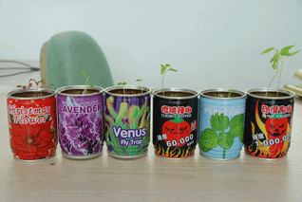
5. VISUALS AIDS
80% of what we learn is learned visually (what we see) and only 20% is learned aurally (what we hear)
What are visuals?

Slide 28
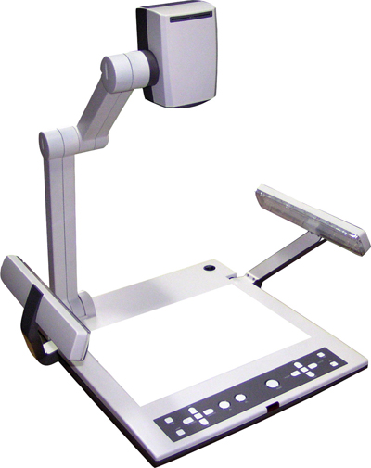
5. VISUALS AIDS
What media are used?

Slide 29
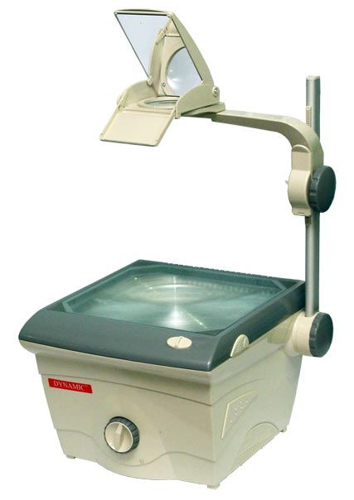
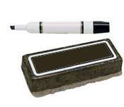
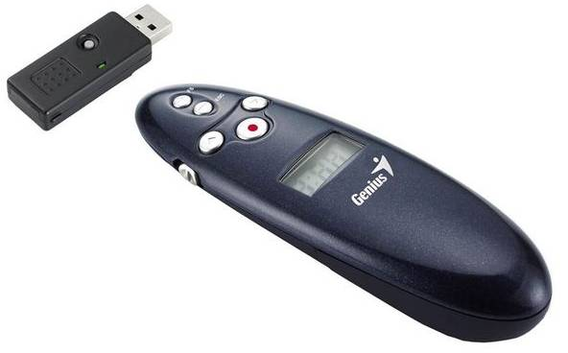
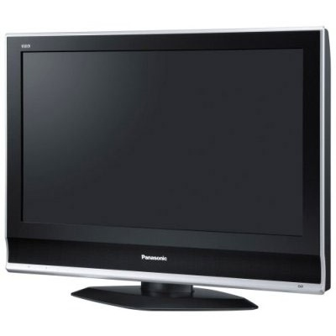
5. VISUALS AIDS
Other possible equipments

Slide 30
5. VISUALS AIDS
What should you put on a visual?
key words technical words
lists examples
diagrams charts

Slide 31
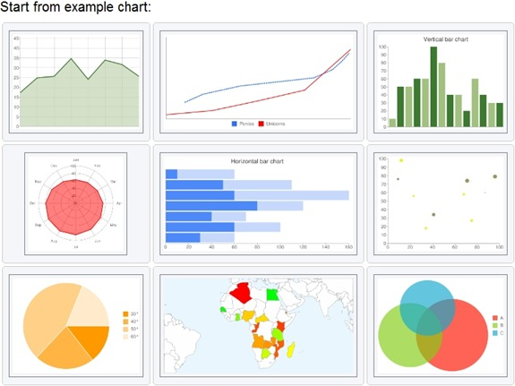
Types of graph/chart

Slide 32
5. VISUALS AIDS
Why we need visuals?
to focus audience's attention
to illustrate points easier to understand in visual form but difficult in verbal form(e.g. statistics)
to reinforce ideas
to change focus from aural/oral to visual
to involve & motivate audience
to involve all senses
to serve as logical proof
to save time and avoid putting information on board
to avoid turning your back to audience when writing on board
to help speaker

Slide 33
5. VISUALS AIDS
Text to put on a visual
name, institution/company and logo, date, title of presentation.
full sentences are not to be used, unless a quote is given, give round figures
N.B. keep text to a minimum

Slide 34
5. VISUALS AIDS
Size, layout, font and size, colors
keep text to a minimum
Size - A4
Layout should be pleasant and easy to read: horizontal/landscape layout is preferable.
Font size - 20 / > depending on room size (A good idea is to use different sizes for different types of text: i.e. 20 for main headings, 16 for subheadings, 14 for other text)
Use CAPITAL LETTERS, bold face, italics, underlining, reverse (white on black) or shading to highlight.

Slide 35
5. VISUALS AIDS
General and miscellaneous tips.
- Have slides ready and in order.
- Check to see if device is working & in focus.
- Test visual to see if people at the back can see it.
- Stand to side of screen & face audience.
- Mask to reveal only what you want audience to see.
Use pointer or pen to draw attention to specific point.

Slide 36
5. VISUALS AIDS
General and miscellaneous tips.
Visuals should be adjusted to audience & supplement spoken message.
Large enough for everyone to see.(Good idea to give out copy)
Do not display too much information, too many colors or typefaces.
Check spelling mistakes or grammatical errors

Slide 37
6. BODY LANGUAGE
"Be natural and relax!"
What is body language?
Eye contact, facial expressions, posture, movements, gestures
Why is it useful?
to clarify meaning; it is very visual
to vent nervousness
to maintain interest
to emphasize and regulate

Slide 38
6. BODY LANGUAGE
Positive body language
Negative body language
eye contact
facial expressions
posture
movement
gesture

Slide 39
7. LANGUAGE
Simplicity and Clarity
- use short words & short sentences
- do not use jargon, unless audience understands it
- talk about concrete facts > abstract ideas
use active verbs instead of passive verbs
Active verbs ➔ much easier to understand & > powerful.
Sentence 1: Honda sold two million scooters last year.
Sentence 2: Two million scooters were sold by Honda last year.

Slide 40
8. VOICE AND PRONUNCIATION
correct pronunciation
vs
incorrect pronunciation
Other factors
Speed
volume
Intonation

Slide 41
Practice
REHEARSAL
REHEARSAL
Practice
Practice
REHEARSAL
REHEARSAL
Practice
REHEARSAL
Practice
REHEARSAL
Practice
Practice
REHEARSAL
REHEARSAL

Slide 42
Thank you very much

